Slide 1




HOTELS DATA
PRESENTATION
Presented by
Sanhita Thangallapalli

Slide 2


INTRODUCTION
We have web scrapped the data from Booking.com website.
In this project we have 5 different places for a vacation on new year.
We have took 3 nights for 2 adults.
We did analysis with the dataset features to generate some actionable insights.
Here CITY with PRICE is the target variable and done visualization to cities and its features.
Let us see the visualizations….
RESERVE A
ROOM
TODAY

Slide 3
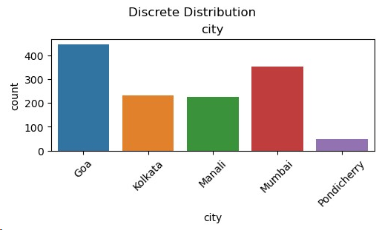
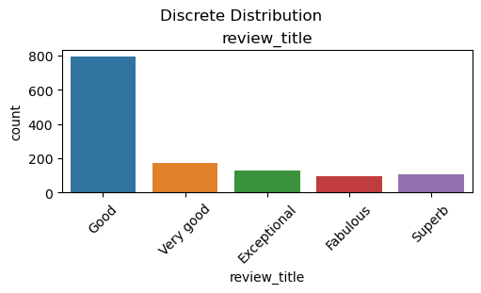
BASIC ANALYSIS
GOA is having More
number of HOTELS compared
to remaining cities.
Many customers are giving reviews as good to the hotels.

Slide 4
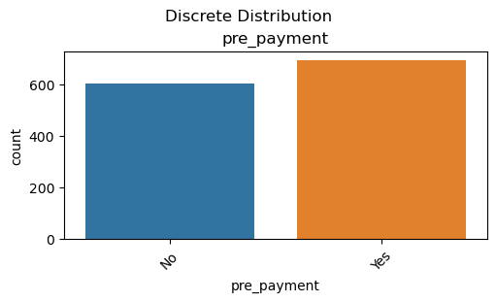
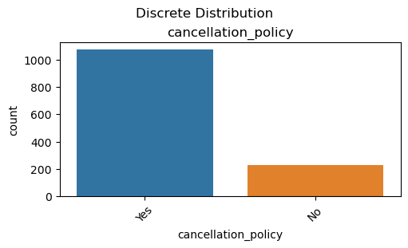
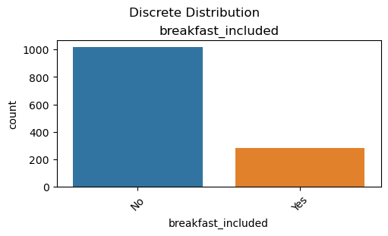
BASIC ANALYSIS
Most of the hotels are providing CANCELLATION POLICY method.
Most of the hotels are Not providing BREAKFAST in their package.
Most of the hotels are providing PRE-PAYMENT method.

Slide 5
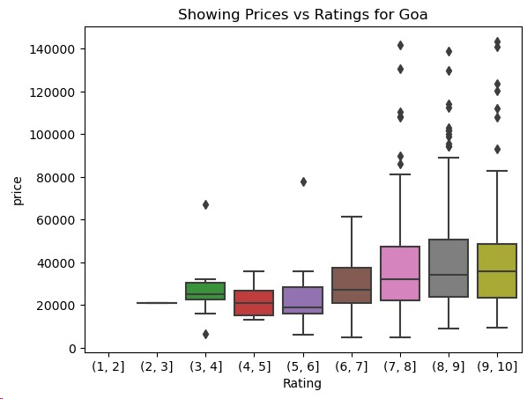
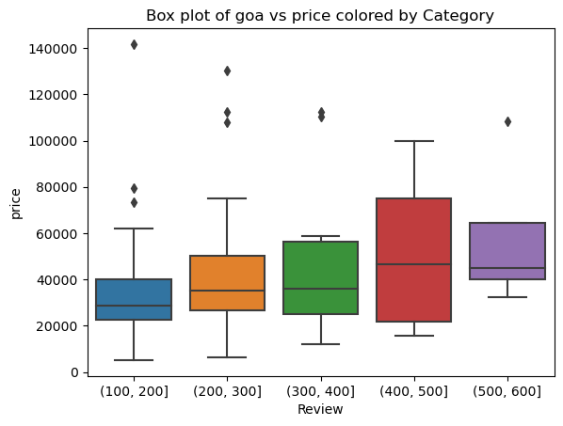
GOA ANALYSIS
RELATIONSHIP BETWEEN THE PRICE AND RATINGS & REVIEWS
As we can see, 20,000 to 50,000 priced hotels
have high ratings for 3 days.
As we can see, most reviews were given to the hotels pricing from 40,000 – 60,000 for 3 days.

Slide 6
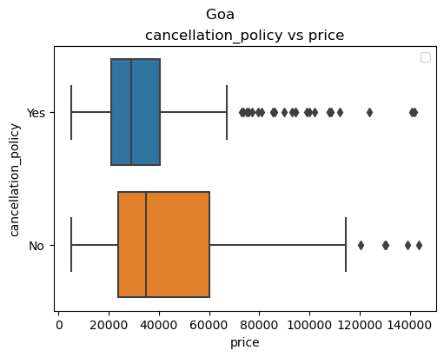
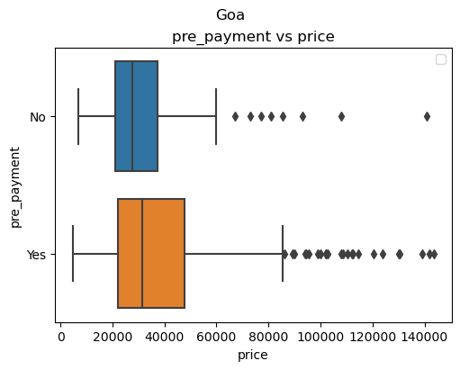
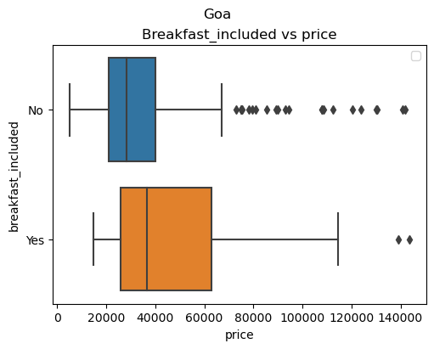
GOA ANALYSIS
CANCELLATION POLICY , PRE-PAYMENT, BREAKFAST WITH PRICE
If we observe, Breakfast_included and Pre-payment was given by the hotels which have price range of 5,000 to 50,000 for 3 days.
Despite of pricing the hotels , they are not providing Cancellation_policy for 3 days.

Slide 7
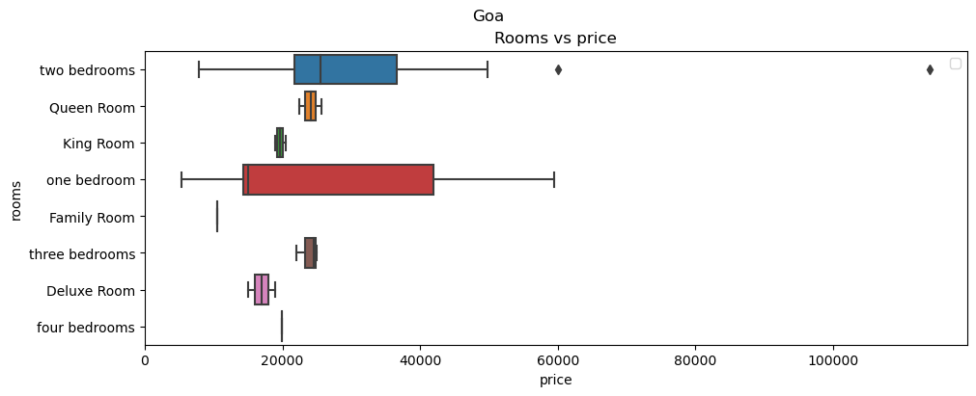
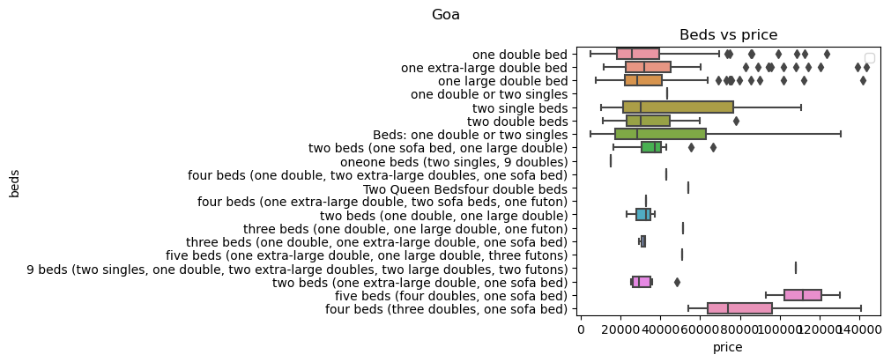
GOA ANALYSIS
RELATIONSHIP BETWEEN THE PRICE AND ROOMS & BEDS
Most of the hotels are offering rooms
with one bedroom.
Most hotels are offering one double or two single beds irrespective of the price.

Slide 8
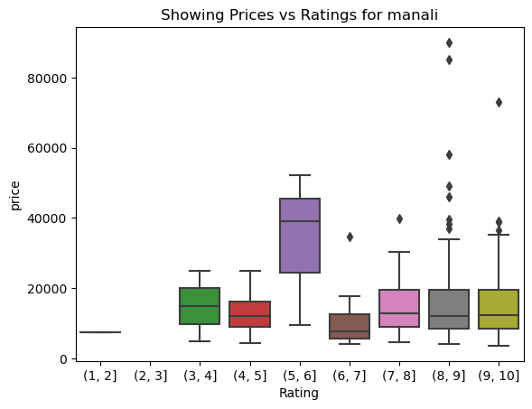
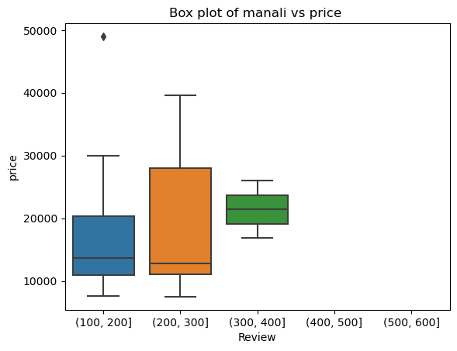
MANALI ANALYSIS
RELATIONSHIP BETWEEN THE PRICE AND RATINGS & REVIEWS
In Manali, the most ratings was given to the hotels pricing between 9000 – 20000 for 3 days.
In Manali, the most reviews was given to the hotels pricing between 10,000 – 30,000 for 3 days.

Slide 9
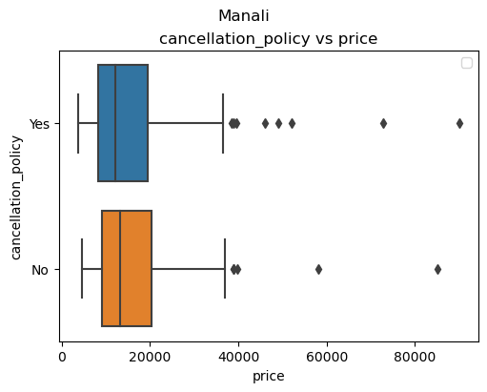
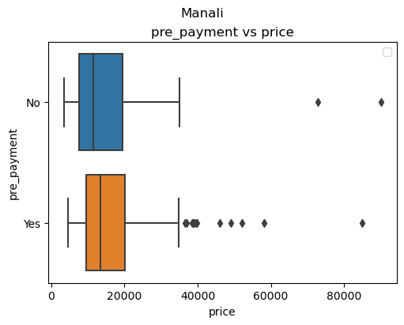
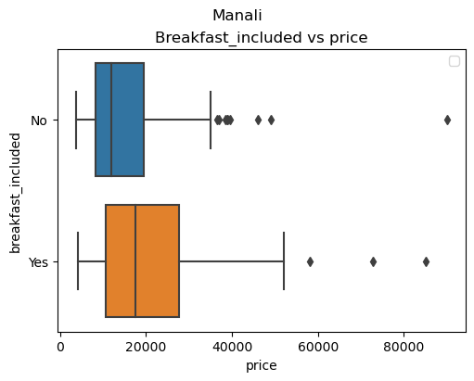
MANALI ANALYSIS
CANCELLATION POLICY , PRE-PAYMENT, BREAKFAST WITH PRICE
If we observe, Cancellation policy and Pre-payment was given by the hotels which have price range of approx. 5,000 to 25,000 for 3 days.
They are not providing Breakfast for least priced hotels for 3 days.

Slide 10
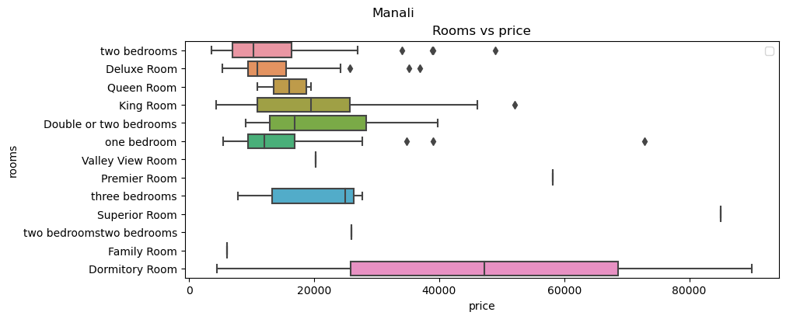
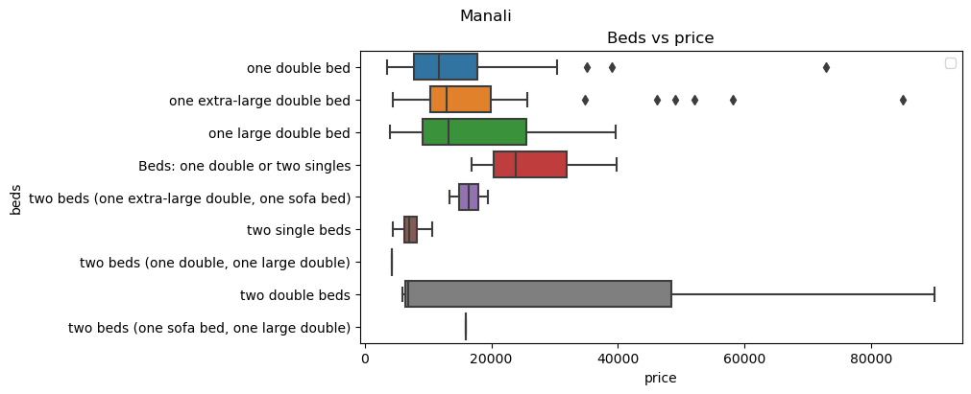
MANALI ANALYSIS
RELATIONSHIP BETWEEN THE PRICE AND ROOMS & BEDS
Most hotels are offering Dormitory Room with high price .
Budget friendly hotels are offering two bedrooms
Most hotels are offering two double beds irrespective
of the price.

Slide 11
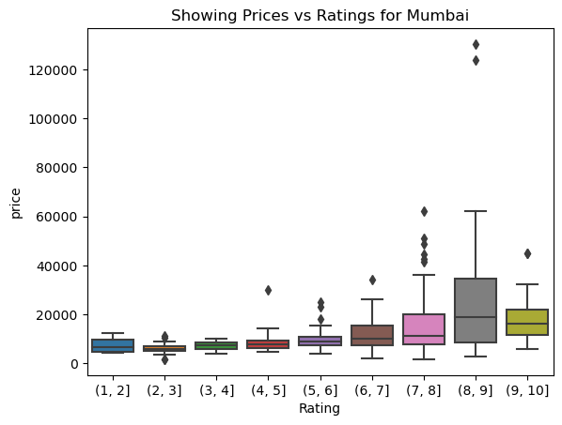
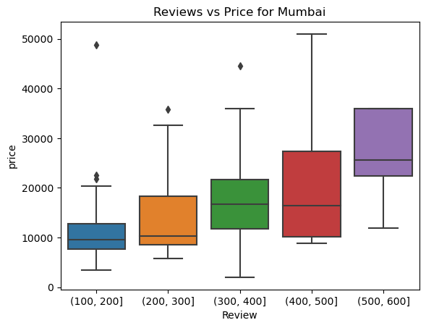
MUMBAI ANALYSIS
RELATIONSHIP BETWEEN THE PRICE AND RATINGS & REVIEWS
Rating is directly proportional to Price. There is a linear increase.
Reviews is directly proportional to Price. There is a linear increase.

Slide 12
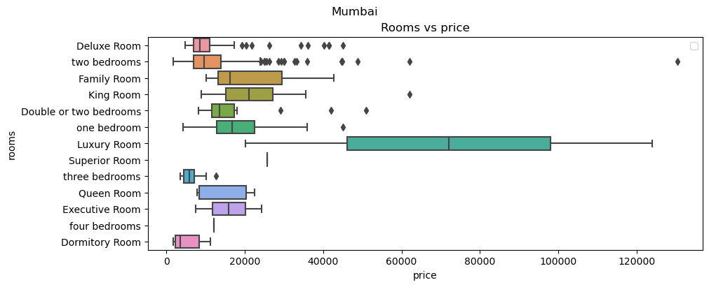
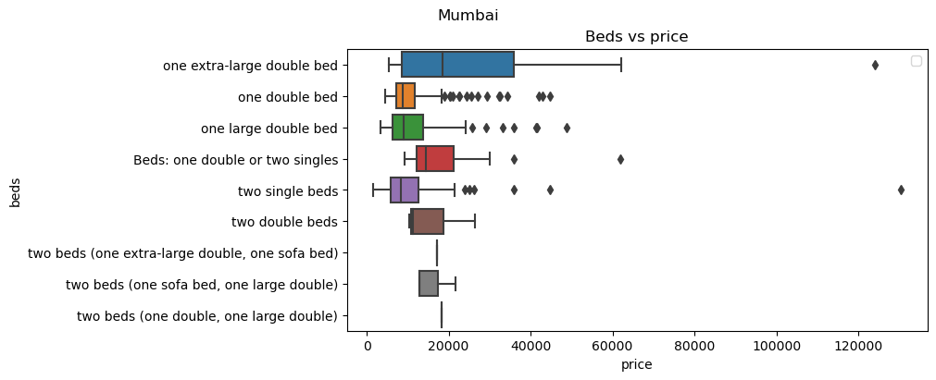
MUMBAI ANALYSIS
RELATIONSHIP BETWEEN THE PRICE AND ROOMS & BEDS
Except for Luxury rooms, all rooms are budget-friendly.
Most hotels are offering one extra-large double bed for budget-friendly prices.

Slide 13
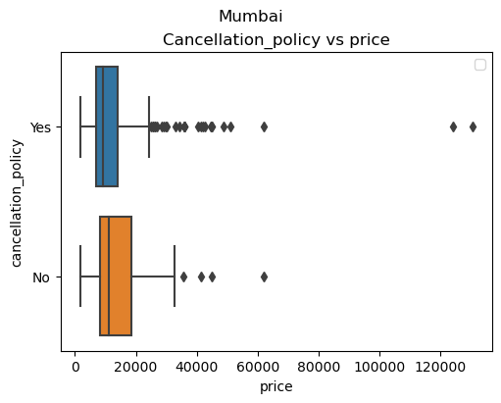
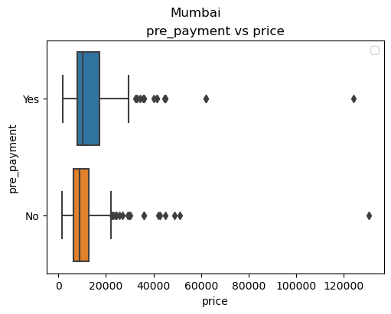
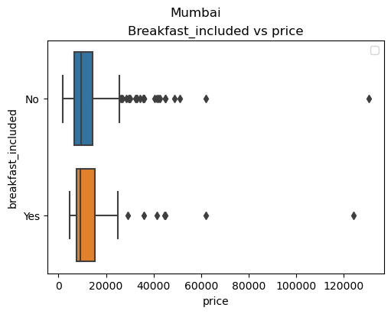
MUMBAI ANALYSIS
CANCELLATION POLICY , PRE-PAYMENT, BREAKFAST WITH PRICE
If we observe, Cancellation policy was given by the hotels which have price range of 5,000 to 20,000 for 3 days.
Despite of pricing of the hotels , they are not providing Breakfast and also Pre-payment for 3 days.

Slide 14
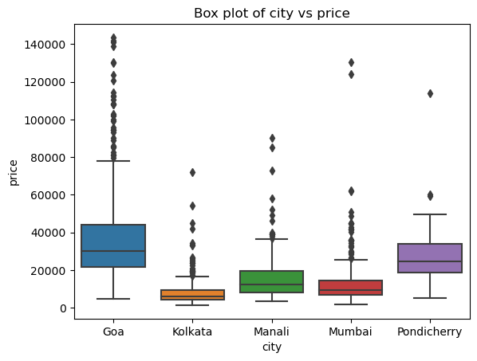
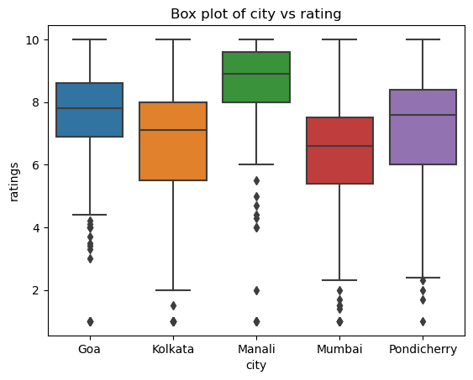
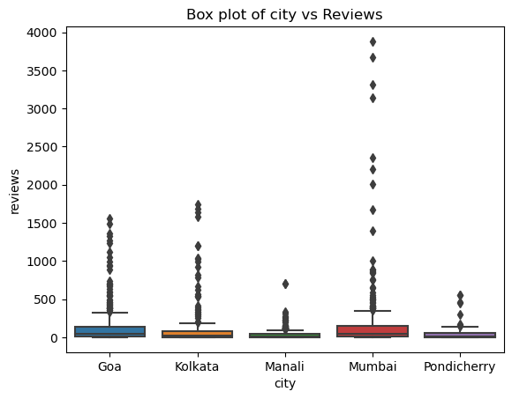
CITY ANALYSIS
RELATIONSHIP BETWEEN THE PRICE AND RATINGS & REVIEWS
The hotels prices in GOA are high following with PONDICHERRY.
The hotels Ratings in MANALI are high following with GOA.
The hotels Reviews in MUMBAI are high following with GOA

Slide 15
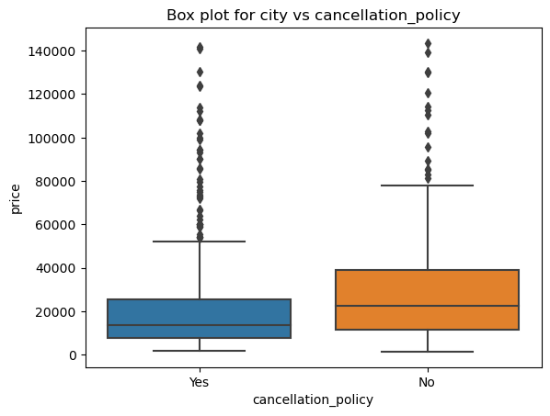
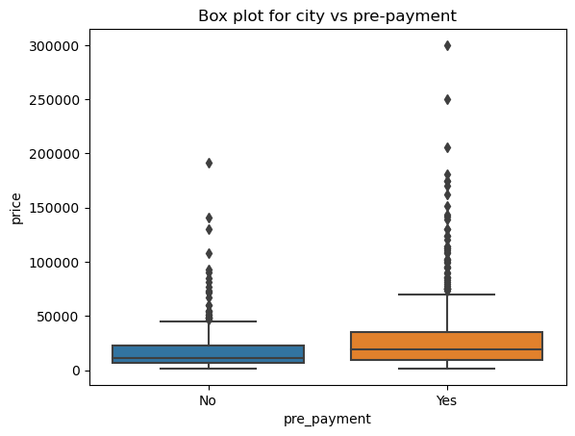
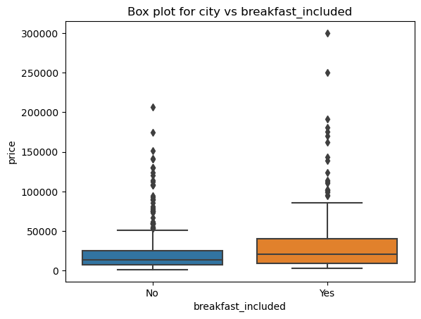
CITY ANALYSIS
CANCELLATION POLICY , PRE-PAYMENT, BREAKFAST WITH PRICE
If we observe, Cancellation policy was given by the hotels which have price range of 10,000 to 25,000 for 3 days.
Despite of pricing of the hotels , they are providing Breakfast and also Pre-payment for 3 days.

Slide 16




CONCLUSION
GOA has MORE HOTELS than any other places.
HOTEL prices are HIGH in GOA and low in KOLKATA.
HOTEL ratings are HIGH in MANALI and low in MUMBAI.
HOTEL reviews are HIGH in MUMBAI and low in MANALI.
All city hotels are PROVIDING cancellation policy.
GOA and MANALI hotels are providing PRE-PAYMENT method remaining are not providing.
All city hotels are providing BREAKFAST.
MANALI is providing budget-friendly beds and rooms.

Slide 17
REFERENCES
https://www.booking.com/searchresults.en-gb.html?ss=Hyderabad&ssne=Hyderabad&ssne_untouched=Hyderabad&label=in-HvtKIh8HYqxrATaP24vtSgS349936091667%3Apl%3Ata%3Ap1%3Ap2%3Aac%3Aap%3Aneg%3Afi%3Atikwd-303403359744%3Alp9184868%3Ali%3Adec%3Adm%3Appccp%3DUmFuZG9tSVYkc2RlIyh9YfpWGnRw6lOGgfEoJVv7zYo&sid=49db4671a2cc3f2996a345fbf0662de4&aid=1610687&lang=en-gb&sb=1&src_elem=sb&src=searchresults&dest_id=-2097701&dest_type=city&checkin=2023-12-31&checkout=2024-01-02&group_adults=2&no_rooms=1&group_children=0
https://github.com/bansalkanav/Machine_Learning_and_Deep_Learning

Slide 18

